Slide 1

Akira Ransomware

Slide 2
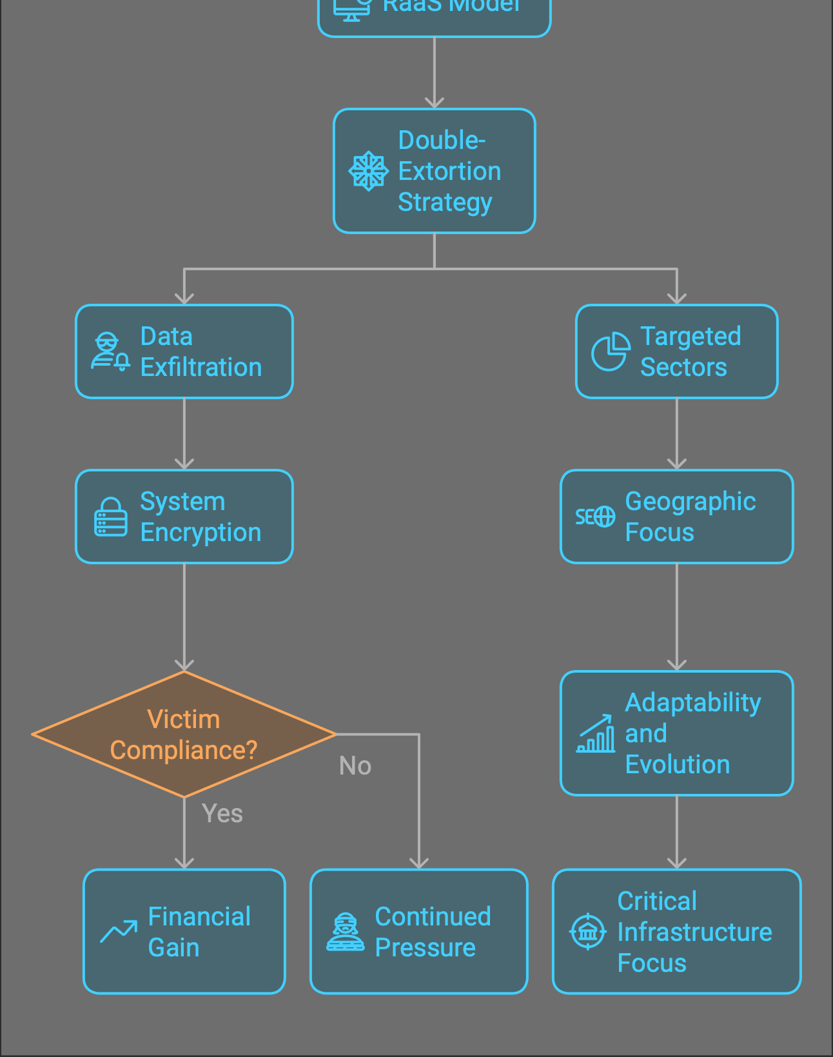
Akira ransomware has cemented its position as a significant threat in 2024, demonstrating adaptability and continuous evolution.
The group employs a double-extortion tactic, exfiltrating sensitive data before encrypting victim systems.
Notes:
While primarily targeting Windows and Linux environments, Akira has shown a particular interest in VMware’s ESXi and Linux environments due to their prevalence in critical infrastructure.

Slide 3
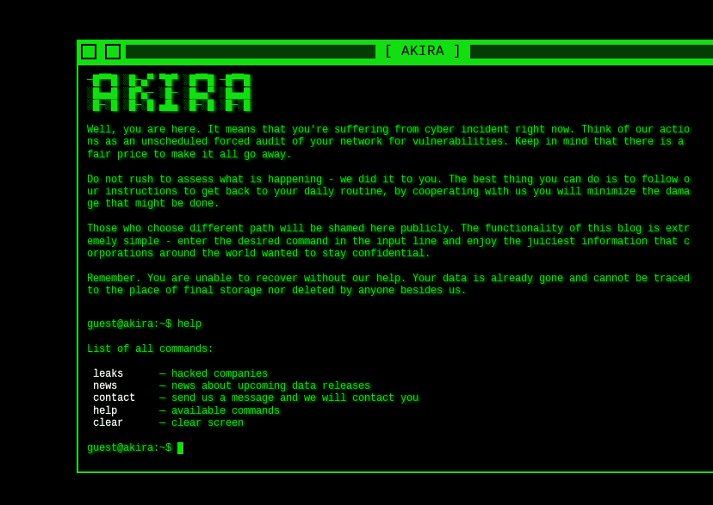
Akira ransomware-as-a-service (RaaS) that has become one of the more prominent players in the current ransomware landscape. According to this update, for a while in early 2024.
Executables written in Rust have a reputation for being particularly challenging to reverse-engineer.
Notes:
Akira affiliates experimented with promoting a new cross-platform variant of the ransomware called “Akira v2.” This new version was written in Rust and was capable of targeting ESXi bare metal hypervisor servers.
While it is often possible to answer specific research questions, such as “What file extensions are being targeted?” or “What encryption method is being used?”, this is usually achieved by finding ways to circumvent a comprehensive analysis at the assembly level. This is, of course, a pragmatic and cost-effective approach. However, if we set it aside for a moment, we might glean some interesting insights.

Slide 4
Observed Tools and Techniques:
Exploitation of Public-Facing Applications: Use of CVEs in unpatched systems.
2. Credential Dumping: Tools like Mimikatz and custom scripts.
3. Lateral Movement: Exploits SMB shares for network propagation.
4. Data Encryption: Targets critical servers and endpoints, leaving ransom notes.

Slide 5
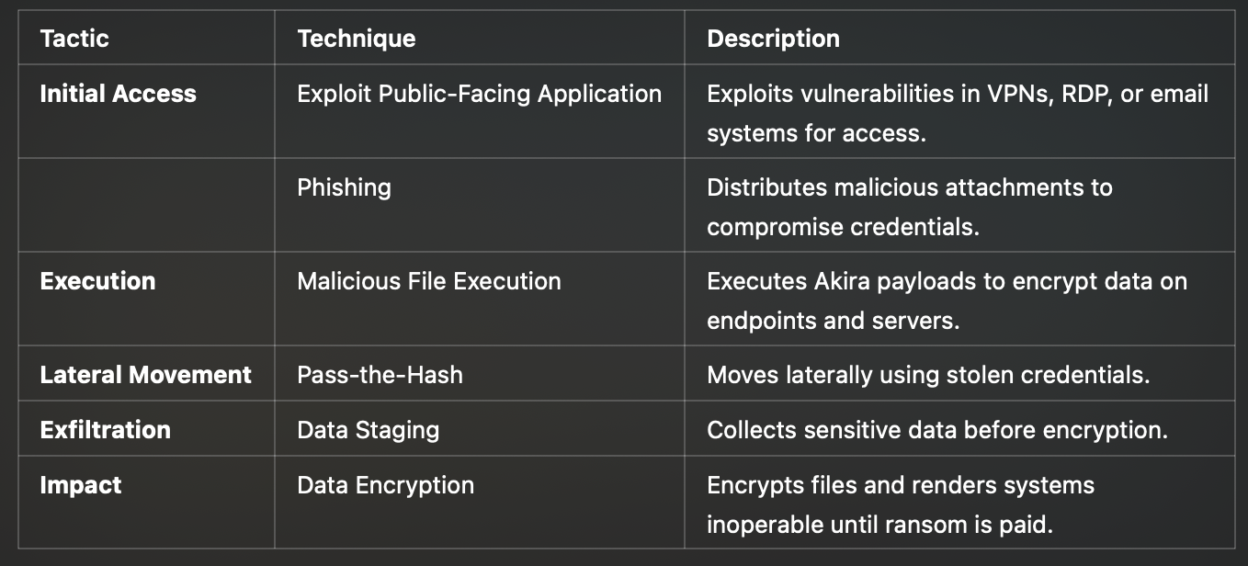
Detailed Tactics, Techniques, and Procedures (TTPs)
Notes:
Here's a summary of the key tactics, techniques, and descriptions:
Initial Access
Exploit Public-Facing Application: Attackers exploit vulnerabilities in VPNs, RDP, or email systems to gain access.
Phishing: Distributes malicious attachments to compromise credentials.
Execution
Malicious File Execution: Executes Akira payloads to encrypt data on endpoints and servers.
Lateral Movement
Pass-the-Hash: Uses stolen credentials to move laterally within the network.
Exfiltration
Data Staging: Collects sensitive data before encryption.
Impact
Data Encryption: Encrypts files and renders systems inoperable until ransom is paid.
Would you like to dive deeper into any of these tactics or techniques?

Slide 6
Additional vulnerabilities leveraged by affiliates throughout 2024 include:
Akira ransomware operators have utilized a variety of common infection vectors to gain initial access to targeted networks, often favoring the use of compromised VPN credentials.
Additional vulnerabilities leveraged by affiliates throughout 2024 include:
CVE-2020-3259 and CVE-2023-20263: In similar Cisco security appliance exploits leveraged in early 2024, Akira was observed abusing a flaw in Cisco Adaptive Security Appliance (ASA) with CVE-2020-3259 and CVE-2023-20263 via Firepower Threat Defense (FTD) software that allowed attackers to execute arbitrary code, after initial access was established post Cisco AnyConnect SSL VPN compromise.
CVE-2023-48788: Exposed and vulnerable FortiClientEMS software abuse by Akira was observed for initial access, enabling lateral movement and privilege escalation.
Notes:
Most recently, Akira ransomware affiliates have been observed targeting network appliances vulnerable to CVE-2024-40766, an exploit in the SonicWall SonicOS facilitating remote code execution on the vulnerable device. Security researchers found that software on the affected systems was vulnerable to this exploit, suggesting affiliates’ swift capitalization on exposed systems.
Here's a summary of the key points regarding Akira ransomware operators:
Initial Access: Akira ransomware operators often use compromised VPN credentials to gain initial access to targeted networks.
Exploited Vulnerabilities:
CVE-2020-3259 and CVE-2023-20263: These vulnerabilities in Cisco Adaptive Security Appliance (ASA) and Firepower Threat Defense (FTD) software allow attackers to execute arbitrary code after initial access is established via Cisco AnyConnect SSL VPN compromise.
CVE-2023-48788: This vulnerability in FortiClientEMS software is exploited for initial access, enabling lateral movement and privilege escalation.
These points highlight the methods and vulnerabilities used by Akira ransomware operators to infiltrate networks and escalate their attacks.

Slide 7
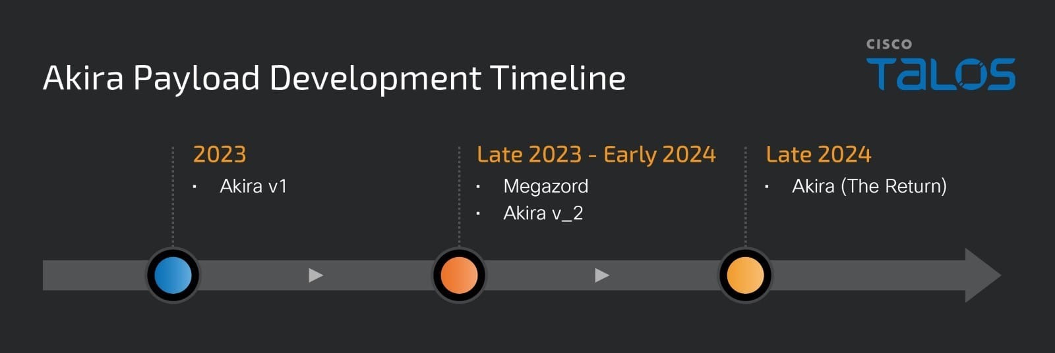
Notes:
Technical Analysis:
Akira v1: Written in C++, using Microsoft Enhanced RSA and AES Cryptographic Provider for encryption. Drops a ransom note named “akira_readme.txt”.
Akira v2: A Rust variant targeting ESXi hosts, using the rust-crypto 0.2.36 library crate for encryption. Appends the file extension “.akiranew” and drops a ransom note named “akiranew.txt”.
"The Return": Suspected shift back to C++ encryptors for both Windows and Linux. Uses the ChaCha8 stream cipher and exhibits similar exclusion patterns to pre-August 2023 versions.

Slide 8
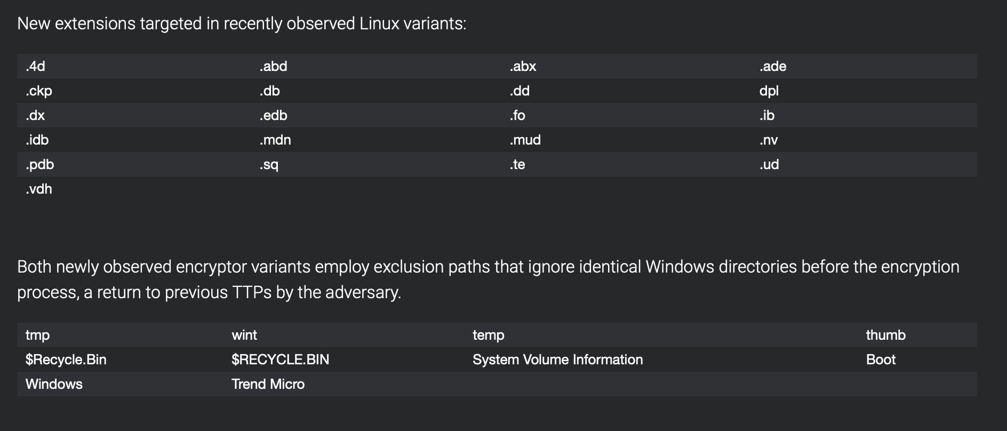
Notes:
The newly observed Windows variant has been updated and appears to substitute the previously seen -remote argument for -localonly and --exclude and excludes paths, including “$Recycle.Bin” and “System Volume Information”, in the encryption process. Within the Linux variant, the –fork argument, which creates a child process for encryption, is still included along with the --exclude argument.
Analysis of the recent binaries suggests that the threat actor has pivoted to utilizing the ChaCha8 stream cipher. The ChaCha8 algorithm is faster and more efficient than the previously leveraged ChaCha20 in Akira v_2 due to the reduced number of quarter-round operations in the cipher, possibly indicating a further focus on swift encryption and exfiltration operations such as seen in recent Akira attacks.

Slide 9
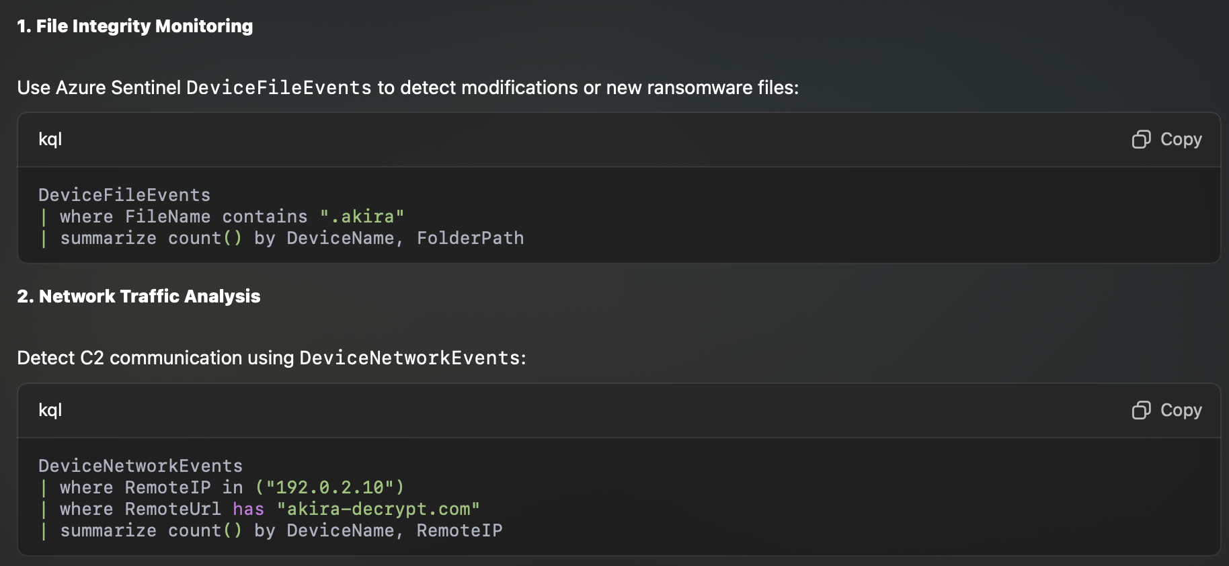
Detection Strategies

Slide 10
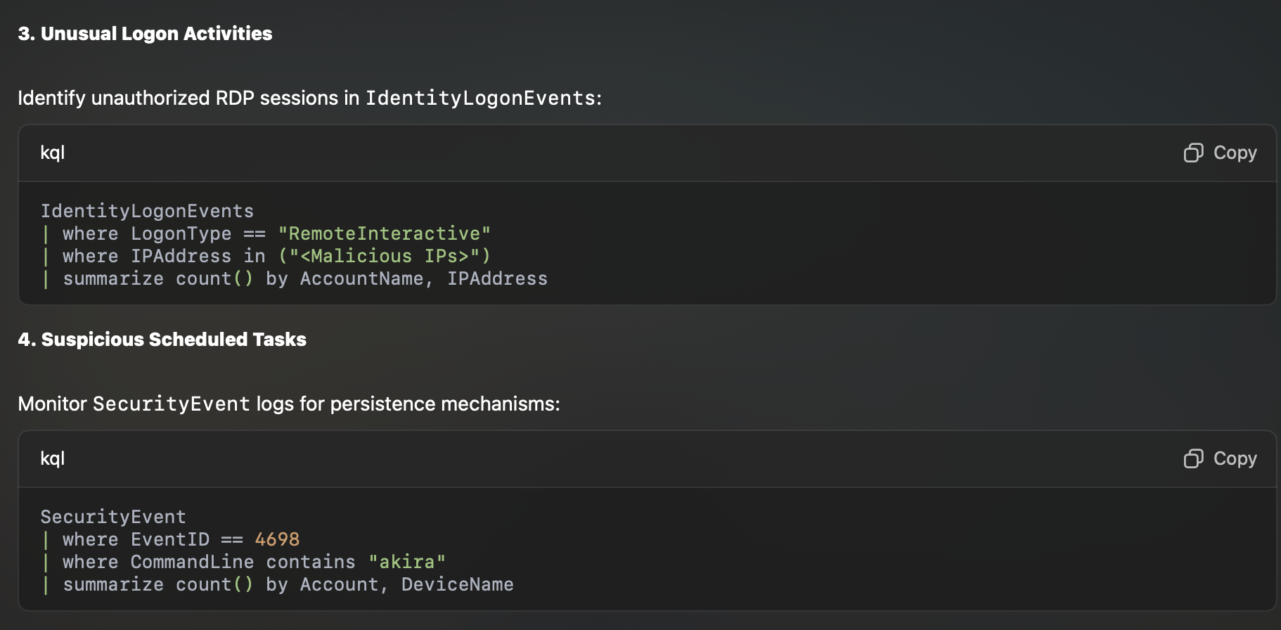

Slide 11
Evolution of TTPs:
Initial Access: Akira utilizes various methods for initial access, including compromised VPN credentials and exploiting vulnerabilities like CVE-2024-40766 (SonicWall SonicOS), CVE-2020-3259 and CVE-2023-20263 (Cisco ASA and FTD), and CVE-2023-48788 (FortiClientEMS).
Lateral Movement & Persistence: Akira exploits further vulnerabilities after initial compromise, including CVE-2023-20269 (Cisco VPN services), CVE-2024-37085 (VMware ESXi), and CVE-2024-40711 (Veeam backup).
Shift to Data Exfiltration: In early 2024, Akira seemingly focused solely on data exfiltration, likely to refine its encryption techniques, as stated by Cisco Talos:
Rust Experimentation: Akira developers experimented with a Rust-based ESXi encryptor (Akira v2) but have potentially reverted to C++ for both Windows and Linux encryptors. This indicates a focus on operational stability and efficiency.
Encryption Techniques: Recent variants utilize the ChaCha8 stream cipher, potentially chosen for its speed and efficiency, suggesting a focus on rapid encryption and exfiltration.
Return to Double Extortion: Akira has likely returned to its previous double-extortion model, combining data theft with encryption for increased leverage.
Focus on ESXi and Linux: Akira actively targets ESXi and Linux environments, aiming to compromise multiple virtual machines and critical workloads simultaneously.
Notes:
"We assess with low to moderate confidence that this shift was due in part to the developers taking time to further retool their encryptor.”
As highlighted by Check Point Research: "While the return to an earlier variant indicates a potential tactical shift from this code migration, it also demonstrates that the developers remain highly adaptable.”
The Check Point research states: "Adversary targeting of these platforms is driven by their prevalence in enterprise infrastructure, hosting critical infrastructure and high-value data, and their capacity for mass encryption and disruption with minimal lateral movement."

Slide 12

Conclusion:
Akira ransomware is a dynamic and evolving threat that poses a significant risk to organizations. Understanding their TTPs and implementing robust security measures is crucial to mitigating the risk of compromise.
Notes:
Continuous monitoring of the threat landscape and adapting security strategies accordingly are essential in the fight against ransomware like Akira.

